Slide 1

About the Presentations
The presentations cover the objectives found in the opening of each chapter.
All chapter objectives are listed in the beginning of each presentation.
You may customize the presentations to fit your class needs.
Some figures from the chapters are included. A complete set of images from the book can be found on the Instructor Resources disc.

Slide 2
An Introduction to Programming with C++
Sixth Edition
Chapter 1
An Introduction to Programming

Slide 3
Objectives
Define the terminology used in programming
Explain the tasks performed by a programmer
Describe the qualities of a good programmer
Understand the employment opportunities for programmers and software engineers
Explain the history of programming languages
An Introduction to Programming with C++, Sixth Edition

Slide 4
Objectives (cont’d.)
Explain the sequence, selection, and repetition structures
Write simple algorithms using the sequence, selection, and repetition structures
An Introduction to Programming with C++, Sixth Edition

Slide 5
Programming a Computer
Programs are the directions given to computers
Programmers are the people who write computer programs
Programming Languages enable programmers to communicate with the computer
  Popular languages: C++, Visual Basic, C#, Java
An Introduction to Programming with C++, Sixth Edition

Slide 6
The Programmer’s Job
Programmers help solve computer problems
Employee or freelance
Typical steps involved
  Meet with user to determine problem
  Convert the problem into a program
  Test the program
  Provide user manual
An Introduction to Programming with C++, Sixth Edition

Slide 7
Do I Have What It Takes to Be a Programmer?
Qualities employers look for
  Logical and analytical thinking
  Close attention to detail
  Patience and persistence
  Ingenuity and creativity
  Good communication skills: technical and nontechnical
  Business skills (for managerial positions)
An Introduction to Programming with C++, Sixth Edition

Slide 8
Employment Opportunities
Computer software engineer: designs an appropriate solution to a user’s problem
Computer programmer: codes a computer solution
Coding is the process of translating a computer solution into a language a computer can understand
Some positions call for both engineering and programming
An Introduction to Programming with C++, Sixth Edition

Slide 9
A Brief History of Programming Languages
Enable programmer to communicate with computer
Different types
  Machine languages
  Assembly languages
  High-level languages
An Introduction to Programming with C++, Sixth Edition

Slide 10
Machine Languages
The first programmers had to write the program instructions using only combinations of 0s and 1s
  Example: 00101 10001 10000
Instructions written in 0s and 1s are called machine language or machine code
Each type of machine has its own language
Machine languages are the only way to communicate directly with the computer
Programming in machine language: tedious and error-prone; requires highly trained programmers
An Introduction to Programming with C++, Sixth Edition

Slide 11
Assembly Languages
Assembly languages simplify programmer’s job
Can use mnemonics instead of 0s and 1s
  Example: ADD bx, ax
Assembly programs require an assembler to convert instructions into machine code
Easier to write programs in assembly language
  But still tedious and requires highly trained programmers
An Introduction to Programming with C++, Sixth Edition

Slide 12
High-Level Languages
High-level languages allow programmer to use English-like instructions
  Example: grossPay = hours * rate
  High-level languages are more machine independent
    Programs written in a high-level language can be used on many different types of computers
Compilers translate high-level instructions into 0s and 1s (machine language)
Interpreters translate the program line by line as the program is running
An Introduction to Programming with C++, Sixth Edition

Slide 13
High-Level Languages (cont’d.)
When writing a procedure-oriented program, the programmer concentrates on the major tasks that the program needs to perform
  Examples: COBOL, BASIC, C
An object-oriented program requires programmer to focus on the objects that the program can use to accomplish its goal
  Examples: C++, Visual Basic, Java, C#
Object-oriented programs allow for better code-reuse
  An object can be used in more than one program
An Introduction to Programming with C++, Sixth Edition

Slide 14
Control Structures
Programs are written using three basic structures
  Sequence
    Used in every program you write
  Repetition
    Used in most programs you write
  Selection
    Used in most programs you write
These are called control structures or logic structures
An Introduction to Programming with C++, Sixth Edition

Slide 15
The Sequence Structure
The sequence structure directs the computer to process the program instructions, one after another, in the order listed in the program
An algorithm is a set of step-by-step instructions that accomplish a task
Example: following a recipe to make cookies
An Introduction to Programming with C++, Sixth Edition

Slide 16
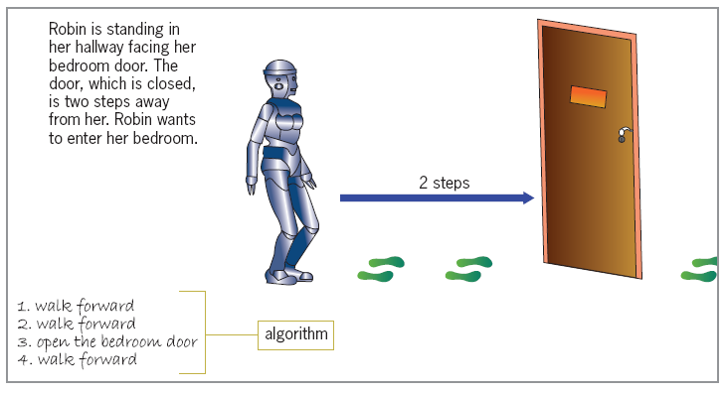
The Sequence Structure (cont’d.)
Figure 1-1 An example of the sequence structure
An Introduction to Programming with C++, Sixth Edition

Slide 17
The Selection Structure
Selection structure: makes a decision and then takes an appropriate action based on that decision
  Also called the decision structure
Example: waiting or crossing at railroad tracks depending on signal lights
An Introduction to Programming with C++, Sixth Edition

Slide 18
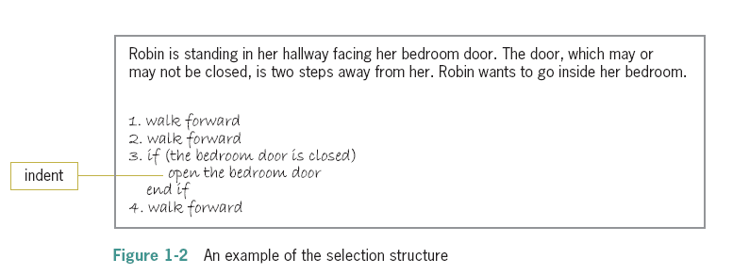
The Selection Structure (cont’d.)
Figure 1-2 An example of the selection structure
An Introduction to Programming with C++, Sixth Edition

Slide 19
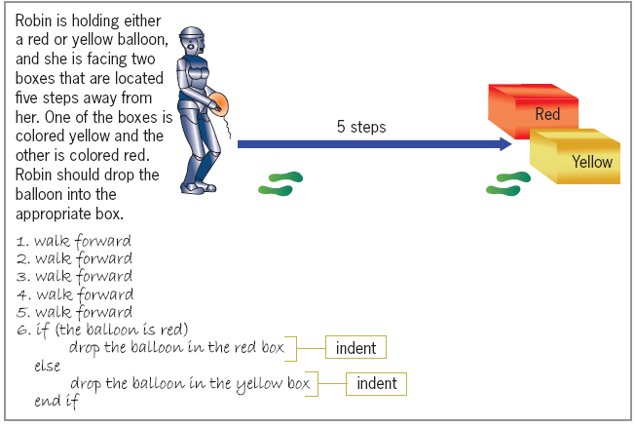
The Selection Structure (cont’d.)
Figure 1-3 Another example of the selection structure
An Introduction to Programming with C++, Sixth Edition

Slide 20
The Repetition Structure
Repetition structure: directs computer to repeat one or more instructions until some condition is met
  Also called a loop or iteration
An Introduction to Programming with C++, Sixth Edition

Slide 21
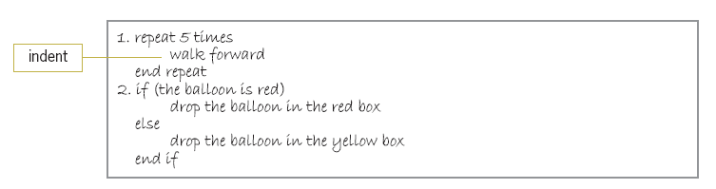
The Repetition Structure (cont’d.)
Figure 1-4 Modified algorithm showing the repetition structure
An Introduction to Programming with C++, Sixth Edition

Slide 22
The Repetition Structure (cont’d.)
What could you do if you don’t know precisely how many steps separate Robin from the boxes?
An Introduction to Programming with C++, Sixth Edition

Slide 23
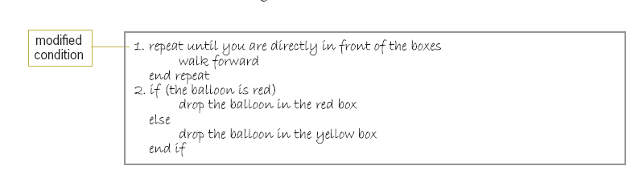
The Repetition Structure (cont’d.)
Figure 1-5 Algorithm showing the modified condition in the repetition structure
An Introduction to Programming with C++, Sixth Edition

Slide 24
Summary
Programs are step-by-step instructions that tell a computer how to perform a task
Programmers use programming languages to communicate with the computer
  First programming languages were machine languages: 0s and 1s (machine code)
  Next came assembly languages, which allowed for mnemonics
  High-level languages can be used to create procedure-oriented programs or object-oriented programs
An Introduction to Programming with C++, Sixth Edition

Slide 25
Summary (cont’d.)
Algorithm: step-by-step instructions that accomplish a task (not written in a programming language)
  Algorithms contain one or more of the following control structures: sequence, selection, and repetition
Sequence structure: process the instructions, one after another, in the order listed
An Introduction to Programming with C++, Sixth Edition

Slide 26
Summary (cont’d.)
Selection structure: directs the computer to make a decision and then to select an appropriate action based on that decision
Repetition structure: repeat one or more instructions until some condition is met
An Introduction to Programming with C++, Sixth Edition

Slide 27
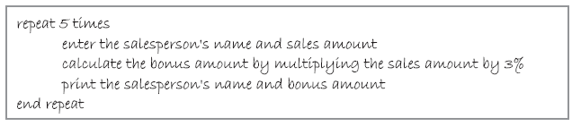
Lab 1-1: Stop and Analyze
A local business employs five salespeople and pays a 3% bonus on a salesperson’s sales
Your task is to create a program that calculates the amount of each salesperson’s bonus
The program should print each salesperson’s name and bonus amount
An Introduction to Programming with C++, Sixth Edition

Slide 28
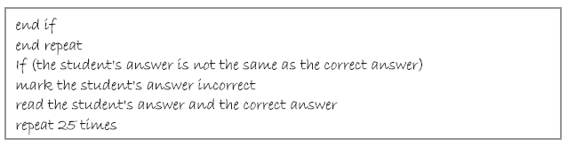
Lab 1-2: Plan and Create
Using only the instructions shown below, create an algorithm that shows the steps an instructor takes when grading a test that contains 25 questions
An Introduction to Programming with C++, Sixth Edition

Slide 29
Lab 1-3: Modify
Modify the algorithm shown in Lab 1-1 so that it gives a 3.5% bonus to salespeople selling more than $2,000
All other salespeople should receive a 3% bonus
An Introduction to Programming with C++, Sixth Edition

